Slide 1

PLANT HYDRATION SYSTEM
SAMPURNA BHATTACHARYA(RA2011026010011)
JAIADITYA GHORPADE(RA2011026010035)
BHAVANI GOWRI SHANKAR(RA2011026010043)
Dr. Dinesh G
Computational Technology

Slide 2


INTRODUCTION
The Robotics-Based Plant Hydration System seeks to revolutionize plant care by leveraging the capabilities of robotics, automation, and artificial intelligence (AI). This system aims to provide precise and adaptive plant hydration, tailored to the unique needs of each plant, while minimizing water wastage and human intervention. By utilizing cutting-edge technologies such as sensors, actuators, and machine learning algorithms, this system has the potential to redefine how we care for our plants, whether they are in our homes, offices, or vast agricultural fields.

Slide 3
ABSTRACT
The system makes smart judgements about when and how much to water the plants by integrating a variety of sensors to monitor soil moisture levels, ambient temperature, and light conditions. The Arduino serves as the robot's main processor, processing sensor data as well as operating the arm and water delivery system. Additionally, the Arduino's networking capabilities allow for remote monitoring and control via a web interface or mobile application, assuring user friendliness.

Slide 4
MOTIVATION OF THE PROJECT
There are several motivations for creating a plant hydration system:
1. Efficient Water Usage: Water conservation is a critical concern in many regions, especially in areas prone to drought or water scarcity. A plant hydration system can help ensure that water is used efficiently by delivering it directly to plants when they need it, reducing wastage.
2. Plant Health: Maintaining optimal soil moisture levels is crucial for the health and growth of plants. A hydration system can help prevent overwatering or underwatering, which can lead to plant stress, disease, or even death.
3. Automation and Convenience: Automating the process of watering plants can save time and effort for gardeners and plant enthusiasts. It ensures that plants receive consistent care, even when individuals are busy or away from home.
4. Optimal Growth: For those who want their plants to thrive and flourish, a hydration system can provide the ideal conditions for growth. Plants that receive the right amount of water, nutrients, and care are more likely to produce healthy foliage and blooms.

Slide 5
MOTIVATION OF THE PROJECT
5. Environmental Sustainability: Reducing water wastage through efficient plant hydration aligns with sustainability goals. It minimizes the environmental impact associated with excessive water usage and promotes responsible gardening practices.
6. Data and Insights: Some plant hydration systems include data logging and analytics capabilities, which can help users gain insights into plant behavior and optimize watering schedules over time.
7. Agricultural Applications: In large-scale agriculture, automated irrigation systems can increase crop yield and efficiency by delivering precise amounts of water to crops.
8. Urban Gardening: Urban gardeners often face space and time constraints. Automated hydration systems can be particularly useful for maintaining planters, vertical gardens, or indoor gardens in urban settings.

Slide 6
INNOVATION IDEA OF THE PROJECT
Here's an innovative idea for a plant hydration system:
*Idea: Smart Hydrogel-Based Plant Hydration System*
Concept:
Create a plant hydration system that uses a smart hydrogel to deliver water to plants in a highly efficient and environmentally friendly way. The system combines emerging technologies and materials to revolutionize how we hydrate plants.
Key Features:
1. Smart Hydrogel Reservoir: Instead of traditional water reservoirs or drip irrigation, the system uses a smart hydrogel as the water storage and delivery medium. Smart hydrogels are materials that can absorb and release water in response to environmental conditions.
2. Sensor Integration: Incorporate advanced sensors for soil moisture, temperature, light levels, and humidity. These sensors provide real-time data to the system.
5. Environmentally Friendly: The smart hydrogel is biodegradable and eco-friendly. It reduces water wastage significantly compared to traditional irrigation systems.

Slide 7
INNOVATION IDEA OF THE PROJECT
.
6. Solar-Powered: Use solar panels to power the system, making it energy-efficient and environmentally sustainable.
8. Adaptive Watering: The system adapts its watering schedule and water release rate based on real-time sensor data, weather forecasts, and the plant's growth stage.
9. Water Quality Monitoring: Incorporate sensors to monitor water quality, ensuring that the water used is free from contaminants that might harm the plants.
10. Data Analytics: Provide users with insights into their plant's growth, hydration history, and recommendations for optimizing plant health.

Slide 8
INNOVATION IDEA OF THE PROJECT
Benefits:
- Highly efficient water usage, reducing water waste and bills.
- Improved plant health and growth due to precise hydration control.
- Environmentally friendly with biodegradable hydrogel and solar power.
- Easy to use and customizable for various plant types.
- Remote monitoring and control for convenience.
Potential Applications:
- Home gardening and landscaping.
- Urban agriculture and rooftop gardens.
- Commercial agriculture and greenhouse farming.
- Research institutions and botanical gardens.

Slide 9
REQUIREMENT GATHERING
Our Auto Plant Watering kit comes with:
5V Relay Module
Soil moisture probes + comparison module
Small submersible pump
50cm tube
Battery pack enclosure
USB power line
Jumper wires
Breadboard
Arduino UNO
Plant

Slide 10
LITERATURE REVIEW
SR NO. | AUTHOR | TITLE | JOURNAL NAME, YEAR
1. | P Sihombing, N A Karina, J T Tarigan and MI Syarif | Automated hydroponics nutrition plants systems using arduino uno microcontroller based on android | IOP SCIENCE, 2018
2. | C. M. Devika; Karthika Bose; S. Vijayalekshmy | Automatic plant irrigation system using Arduino | IEEE,2017
3. | Mohanad Ali Meteab Al-Obaidi, Muna Abdul Hussain Radhi, Rasha Shaker Ibrahim, Tole Sutikno | Technique smart control soil moisture system to watering plant based on IoT with arduino uno | Institute of Advanced Engineering and Science (IAES)
4. | Drashti Divani Pallavi Patil; Sunil K. Punjabi | Automated plant Watering system | IEEE, 2016
5. | Swapnil Bhardwaj; Saru Dhir; Madhurima Hooda | Automatic Plant Watering System using IoT | IEEE,2018

Slide 11
LITERATURE REVIEW
SR NO. | AUTHOR | TITLE | JOURNAL NAME, YEAR
7. | A. Al-Omary ; H.M. AlSabbagh ; H. Al-Rizzo | Cloud based IoT for Smart Garden Watering System using Arduino Uno | IET Digital Library, 2018
8. | Krittin Lekjaroen; Rachatapon Ponganantayotin; Arnon Charoenrat; Suree Funilkul | IoT Planting: Watering system using mobile application for the elderly | IEEE, 2016
9. | Nadia Rahmadina Aristawati | Designing Plant Monitoring System Using Arduino | PKM, 2023
10. | Sudhakar Ajmera Nagaraju Jangam | GSM based water monitoring system for agriculture using arduino UNO | AIP PUBLISHING , 2023

Slide 12
LIMITATION IDENTIFIED FROM SURVEY
1) In present condition, they need to wait until field is fully watered. This restricts them to do other activities.
2)For the future work, this project can be implemented in large scale by using many number of moist sensors and temperature sensors.

Slide 13
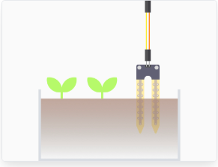
STEPS FOLLOWED
STEP-1
The water content in surrounding air and materials such as soil is an important factor for the well-being of humans, animals, plants, and other living things. The term moisture generally refers to the water content of any material. It is applied to liquids and solids, whereas humidity refers to the water vapor content in gases.
This soil moisture sensor in our kit has two probes to pass current through the soil. It measures the resistance and represents the change in resistance as moisture level. More water makes the soil conduct electricity more easily (less resistance), while dry soil conducts electricity poorly (more resistance). This sensor will be helpful as a reminder to water your indoor plants or to monitor the soil moisture in your garden.

Slide 14
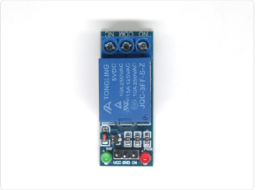
STEPS FOLLOWED
STEP-2
A relay is basically an electrically actuated switch. Many sensors are incredibly sensitive and which may produce only small electric currents. When we need to use them in circuits involving larger currents, that's when relays bridge the gap; A relay makes it possible for small currents to activate larger ones, and to safely do so.
In this guide, the relay is used to turn the submersible water pump on and off.

Slide 15
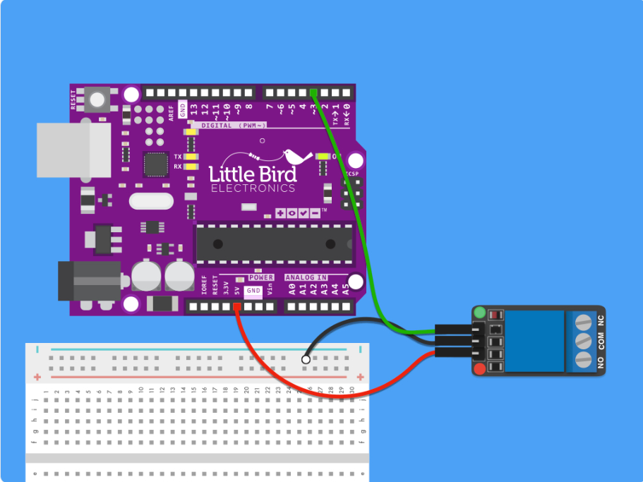
STEPS FOLLOWED
STEP-3
Without further ado, let's get started with connecting up the components. First, connect VCC on the relay to 5V pin on Arduino
Connect GND on the relay to negative power rail of breadboard.
Connect IN on relay to Pin 3 on Arduino.

Slide 16
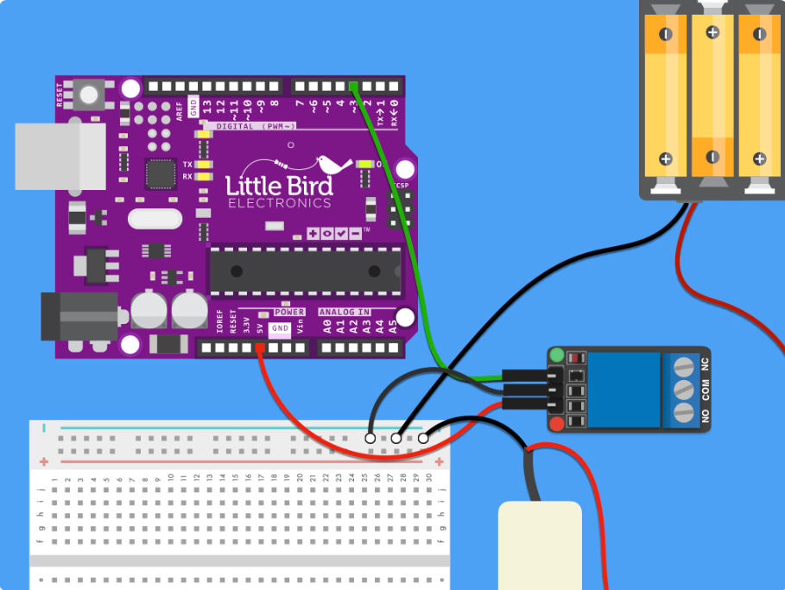
STEPS FOLLOWED
STEP-4
Connect the '-' black wire from battery pack to the negative power rail on the breadboard
Connect to the battery.
Next, connect the black wire of pump to negative power rail.

Slide 17
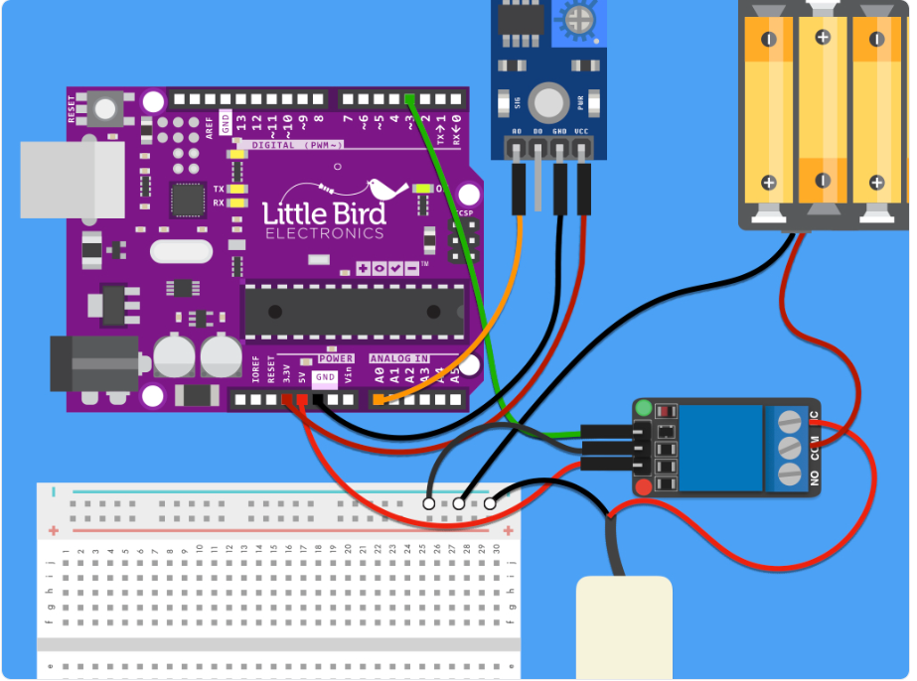
STEPS FOLLOWED
STEP-5
Connect two F-F jumper wires from the soil moisture sensor probe to the comparison module included in the kit.
Connect a F-M jumper wire from AO on the module to A0 on Arduino.
Connect a F-M jumper wire from GND on the module to GND on Arduino.
Connect a F-M jumper wire from VCC on the module to 3.3V on the Arduino.
Connect red wire of pump to NC.
Connect the '+' red wire from battery holder to COM on the relay.

Slide 18
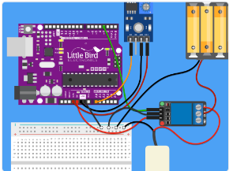
STEPS FOLLOWED
STEP-5
Connect a M-M wire from the negative power rail of breadboard, to GND pin on Arduino
Next, we will get started with programming the Arduino, so connect it to a computer with the Arduino IDE installed.

Slide 19
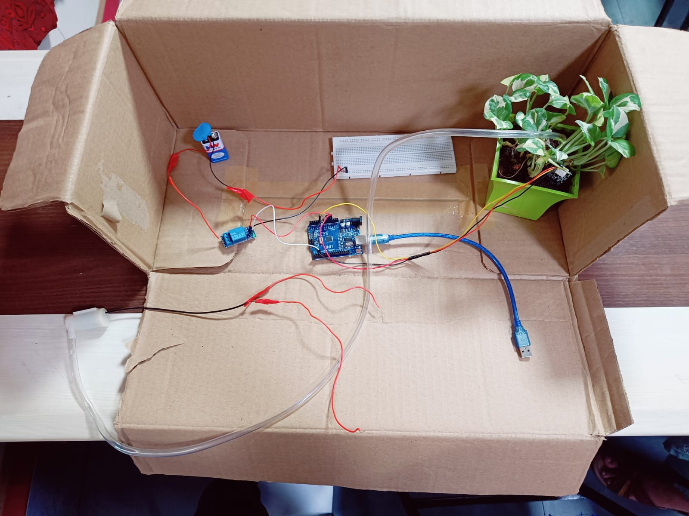

Slide 20
REFERENCES
https://ieeexplore.ieee.org/abstract/document/8326027
https://beei.org/index.php/EEI/article/view/1896
https://ieeexplore.ieee.org/abstract/document/7557245
https://ieeexplore.ieee.org/abstract/document/8753100
https://iopscience.iop.org/article/10.1088/1742-6596/978/1/012014/meta
https://ieeexplore.ieee.org/abstract/document/7859873/authors#authors
https://digital-library.theiet.org/content/conferences/10.1049/cp.2018.1401
https://adpi-indonesia.id/icorad/index.php/home/article/view/84
https://pubs.aip.org/aip/acp/article-abstract/2492/1/020076/2891989/GSM-based-water-monitoring-system-for-agriculture?redirectedFrom=fulltext

Slide 21
THANK YOU

